Slide 1
Secure data hiding in images using steganography
CAPSTONE PROJECT
Presented By : Suraj S
Student Name : Suraj S
College Name : SRM INSTITUTE OF SCIENCE AND TECHNOLOGY
Department : Bsc Computer science

Slide 2
OUTLINE
Problem Statement
Technology used
Wow factor
End users
Result
Conclusion
Git-hub Link
Future scope

Slide 3
Problem Statement
In today’s digital world, secure communication is more important than ever.
Traditional encryption methods are great, but they often reveal that a secret message exists.
The Big Question: How can we hide messages in a way that's invisible and secure?
Our Solution: Use steganography to embed messages within images without visible changes.

Slide 4
Technology used
Python: Our go-to programming language for this project.
OpenCV: A powerful library that helps us manipulate images at the pixel level.
Least Significant Bit (LSB) Technique: A clever method for embedding data in the least significant bits of pixel values.
PNG Format: We use PNG images to ensure the hidden data stays intact without any loss.

Slide 5
Wow factors
Secure Communication: Messages are hidden, making it tough for unauthorized users to detect their presence.
Simple Yet Powerful: Our tool is easy to use with a straightforward command-line interface for encryption and decryption.
Invisible to the Human Eye: The hidden message is added in a way that you won't notice any changes in the image.

Slide 6
End users
Individuals: Perfect for personal use to hide sensitive information in images.
Developers: Use it as a reference for building similar tools or integrating steganography into applications.
Organizations: Ideal for secure communication and data protection within companies.

Slide 7
Results
Successful Encryption : Messages are hidden inside images without any noticeable differences
Successful Decryption: Hidden messages are extracted accurately using our decryption tool
Example:
Original Image: original.jpg
Encrypted Image: encrypted.png
Decrypted Message: "helloeveryone"
Performance: Works efficiently for small to medium-sized images.

Slide 8
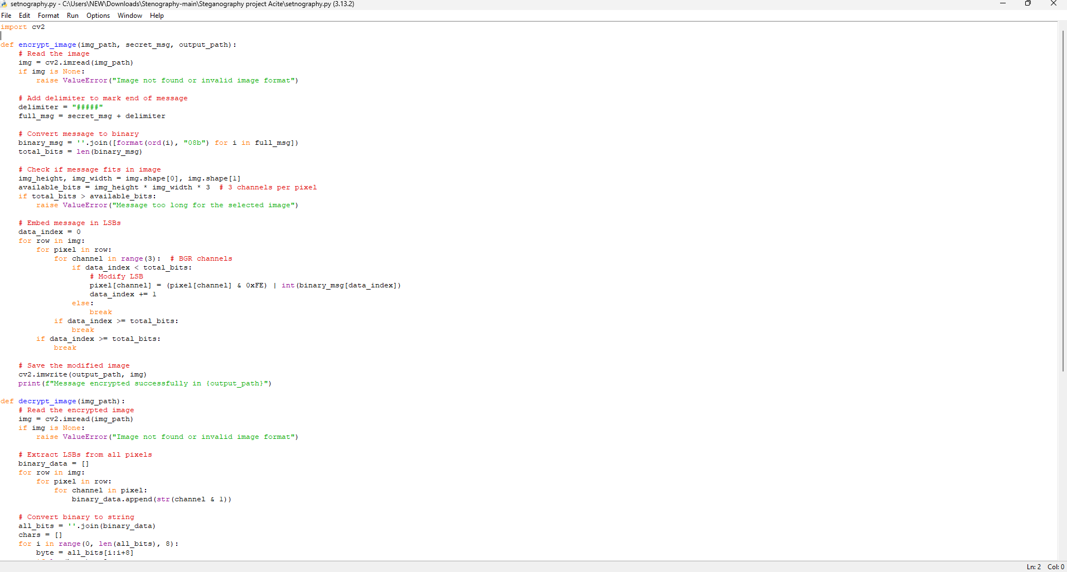
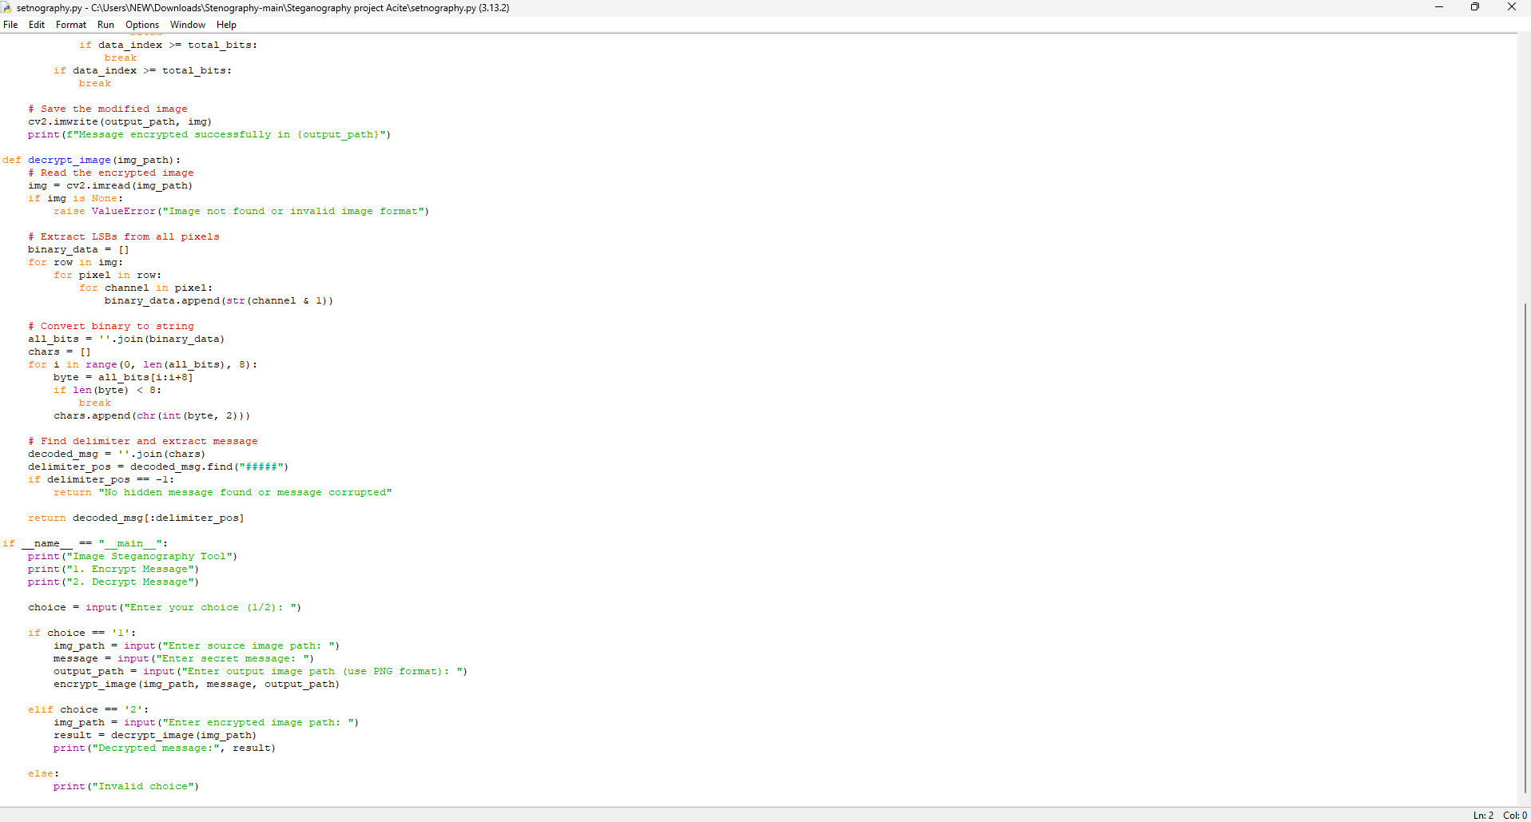
PYTHON CODE

Slide 9
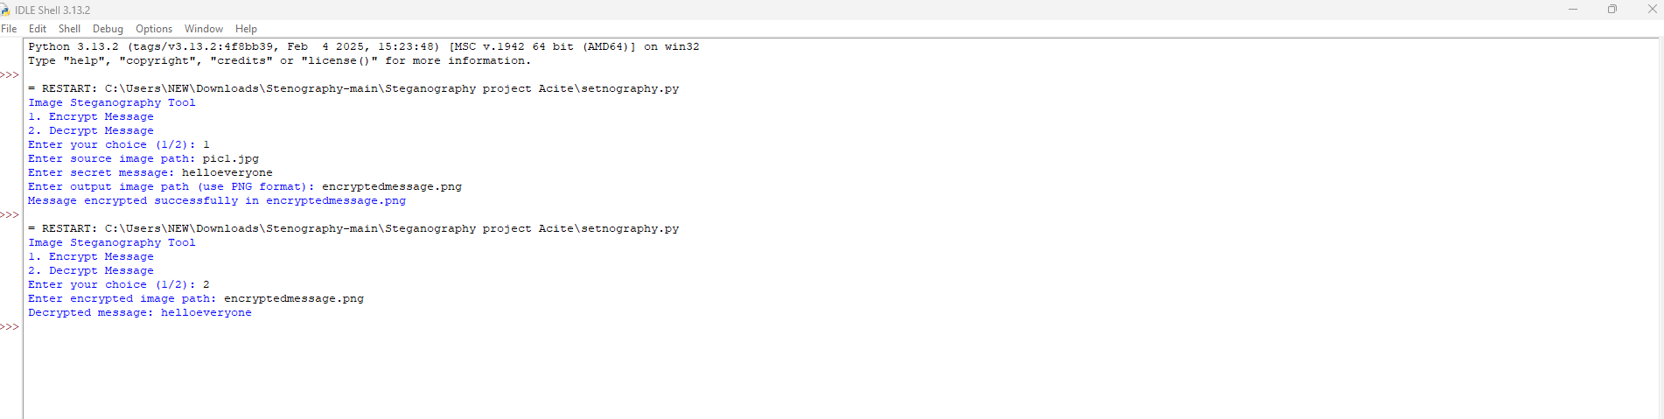
OUTPUT CODE

Slide 10
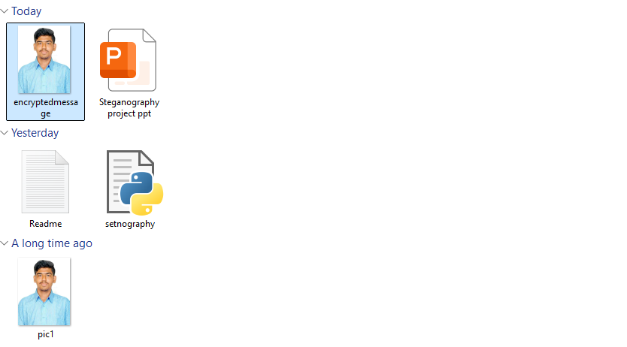
ORIGINAL AND ENCRYPTED IMAGE

Slide 11
Conclusion
Steganography is a fantastic way to hide messages within images.
This project shows how Python and OpenCV can be used to implement steganography effectively.
Our tool is simple, secure, and practical for real-world use.
It serves as a foundation for exploring more advanced steganography techniques.

Slide 12
GitHub Link
https://github.com/Surajithub/Suraj-ACITE-project.git

Slide 13
Future scope(optional)
Advanced Algorithms: We plan to use more complex hiding techniques, like embedding data in the frequency domain of images.
User-Friendly Interface: Creating a user-friendly graphical interface
Support for Other Media: We want to expand the tool to hide messages in audio and video files.
Cloud Integration: We are working on a web-based version of the tool for online use.
Enhanced Security: Adding encryption (e.g., AES) before embedding the message for added security.

Slide 14
THANK YOU

